Slide 1
CS 290– Web Development.

Slide 2
About me
Moulik Kothari
MS in Computer Science from University of New Mexico, in 2006.
Work at U.S.Bank as a Development Lead in Content Management System team.
Recently moved here from Portland.

Slide 3
Computing Resources
Personal Computers
If you do not have a personal laptop that you can bring to class, please talk to me after class.

Slide 4
Introductions
Background with Computer Science
If you are working, what do you do
Have you done any web programming before?
Your take on computer programming; like/dislikes about programming?
What would you like to do past graduation?
What are you expecting to learn from this class

Slide 5
What is this course?
An introduction to making web applications.
Essential training if you want to be a professional software engineer.
It's a 4 credit class - be prepared to work hard!

Slide 6
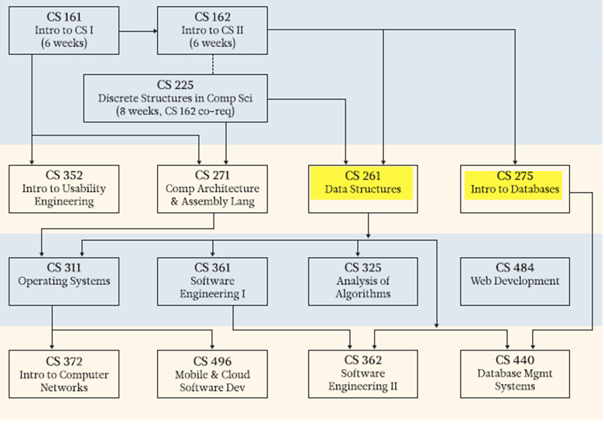

Slide 7
Syllabus
At the completion of the course, students will be able to…
Understand and discuss the language of the Internet and web page authoring
Discuss best practices in web site security, user interface design, content management, and new issues
Envision, design, prototype, produce, test, and promote a web site that uses
Compliant HTML and CSS
Dynamic navigation
Embedded media
Database-driven structure and content
Secure forms with dynamic user interaction
Content Management Systems (CMS) such as blogs, forums, wikis, and galleries

Slide 8
Technologies
You will develop using, interact with or get familiar with the following technologies and concepts in this class.
HTML CSS Javascript Jquery Ajax Nodejs MongoDB | Dynamic Websites Usability Web Security Scalability MVC

Slide 9
Class Breakdown
Divided into three parts, the course structure looks something like this:
First part
Getting started with web technologies
Mostly focused on front-end work
Second part
Mostly focused on back-end support.
Start of Project
Third part
Focused on websites as a whole.
Introduction to other related concepts
Project due.

Slide 10
Grading
Grade is divided as below:
Homework (total) 25%
Class Participation and teamwork 10%
How-To Guide 15%
Project 25%
Final Exam 25%
A | >= 92 %
A- | 90-91
B+ | 87-89
B | 82-86
B- | 80-81
C+ | 77-79
C | 72-76
C- | 70-71
D+ | 67-69
D | 62-66
D- | 60-61
F | <= 59

Slide 11
Pair Programming
All assignments are to be worked in a pair.
First four assignments, you choose a partner.
This partner has to be different than your project partner.
Last three assignments, I may switch people around if I don't see enough teamwork happening.

Slide 12
Final Exam
Multiple Choice questions
Open book, bring your laptops, books if desired
Limited Time.
If every question takes you to online search, you will run out of time quickly.

Slide 13

Syllabus - Questions?

Slide 14
Lets get started
What is the web?
There's no one right answer.
Internet/Intranet - Difference?

Slide 15
How do websites work?
End-User
Browser
Server
Request
Respond
Service
Databases

Slide 16
Primary technologies for the web
Hypertext markup language (HTML)
Cascading style sheets (CSS)
JavaScript (JS)
PHP, Perl, ASP, JSP, Python, Java, C#....
SQL Database

Slide 17
Primary technologies for the web
Hypertext markup language (HTML)
Cascading style sheets (CSS)
JavaScript (JS)
PHP, Perl, ASP, JSP, Python, Java, C#
Structured query language (SQL)
Back end JavaScript
MongoDB – Non Structured Database

Slide 18
HTML

Slide 19
Hypertext markup language (HTML)
This is the language used to “write” web pages
It describes what is “on” a web page
HTML is necessary because without it, your web page is empty.

Slide 20
HTML
<html>
<head>
<title>Page Title</title>
<!-- what else?-->
</head>
<body>
<b>Welcome to the class!</b>
<br/>
Learning web development when I'd rather be skiing..
</body>
</html>

Slide 21
Viewing your HTML
Save your file.
Open the file in your browser.

Slide 22
HTML -Notes
Not case sensitive.
Every opening tag does not have to have a closing tag – BUT – please close them.
General programming guidelines – indentation, blank lines, comments, apply here just as much.
After Class: Search “what’s new in HTML 5”

Slide 23
Javascript (JS)
This is the language used to write the programs than run in the browser.
JavaScript is awesome because it enables web pages to “feel” very interactive.
It's not uncommon for a website to have more JS code than HTML.

Slide 24
Javascript
What would you use Javascript for?
Clue: What constitutes 'interaction' on a website.

Slide 25
CSS
This is the language used to control the appearance of web pages.
You can control appearance of web pages using just HTML (so in theory, CSS is optional).

Slide 26
CSS
What do you use CSS for?

Slide 27
Browser
What browser do you use?
Why?
What do browsers primarily do?

Slide 28
Personal home page (PHP)
This is the language used to write programs that run on the server.
There are very very many quite worthy alternatives (including Java, Ruby, and C#).
But PHP is easy to learn and widely available, so we will use it in this intro course.

Slide 29
Structured query language (SQL)
This is the language used to tell the database what to do (including read and write data).
There are alternatives, but none of them are as widely supported or standardized.*
SQL (or one of those alternatives) is typically used when you need to manage lots of data.

Slide 30
Node.js
Your browser runs a javascript engine. What if we separate that engine so you can run javascript outside of your browser?
Node.js is a javascript based runtime environment used on the back-end
Event-Driven
Asynchronous

Slide 31
Express.js
Express is a Node.js framework.
Makes building applications using node.js easier and quicker.
It handles all the basic tasks your web application would have to do.
There are other frameworks available too. We will cover this in more detail later in the class

